Slide 1
Sound Intensity detection using Arduino
By:-
Nitin Kumar Chauhan
Om Prakash Kumar

Slide 2
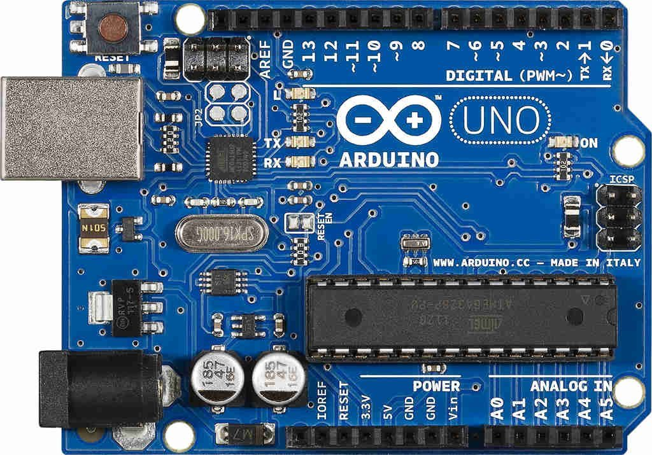
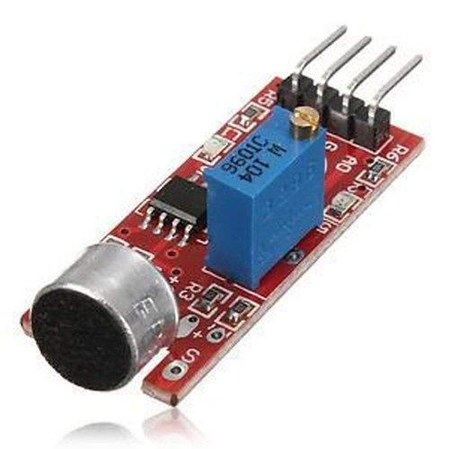
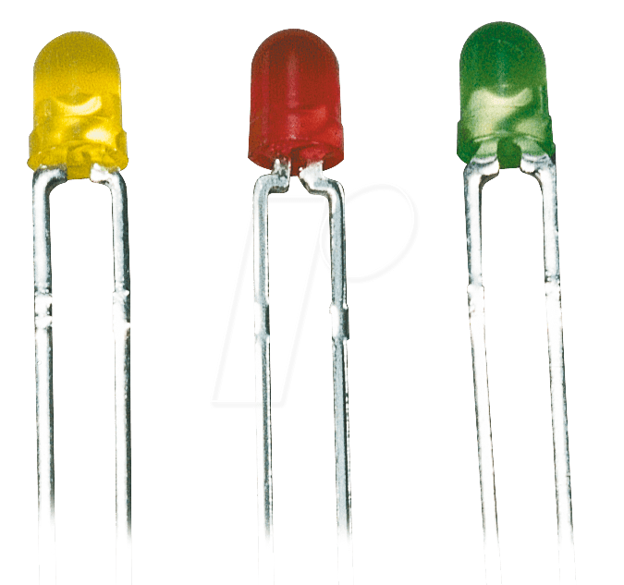
Components Used
LCD Screen
Jumper Wires
Arduino UNO
3 LED’s
Spark Sound Sensor

Slide 3
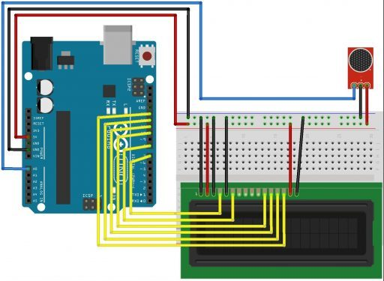
Circuit Diagram

Slide 4
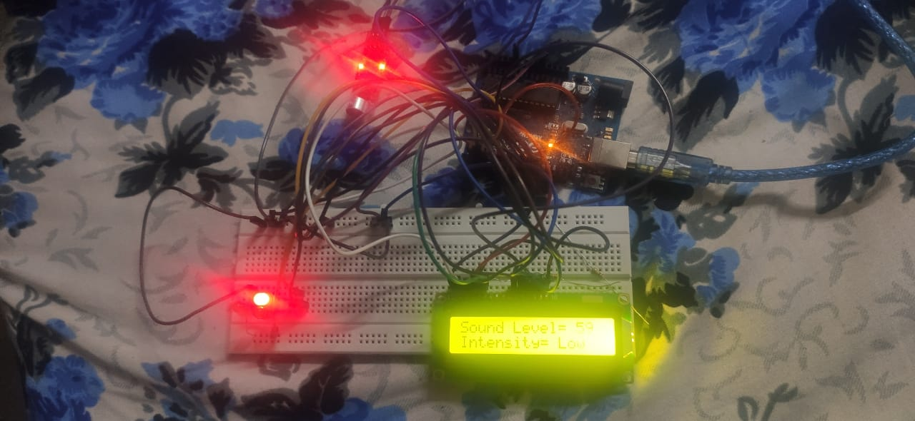
Connections

Slide 5
Working
The sound sensor is detecting the sound and converting it to electrical pulses, which subsequently prints on the LCD screen. Now depending on the sound intensity, the 3 LEDs glow.
The RED when the sound intensity is low. The YELLOW when the sound intensity is medium, and the green when the sound intensity is high.

Slide 6
Applications
With the sound intensity measurement, we can separate the sound sources.
We can identify the noise source identification.
Common applications involve sound power of an object.

